Slide 1


Building a Web App for Data Exploration with Smart Mapping
Esri Developer Summit
March 8–11, 2016 | Palm Springs, CA
Kristian Ekenes and Jeremy Bartley
Notes:
[KRISTIAN]

Slide 2
Sample App
Seattle Demographics

Slide 3

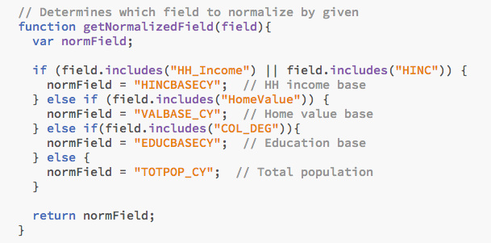


Slide 4
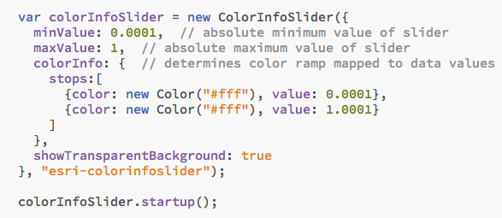

Slide 5
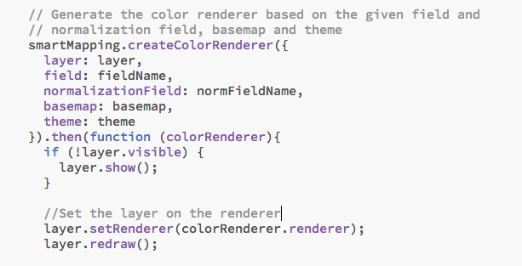
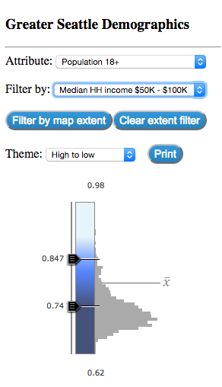

Slide 6
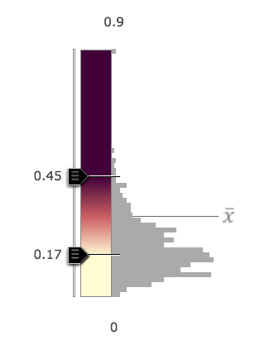
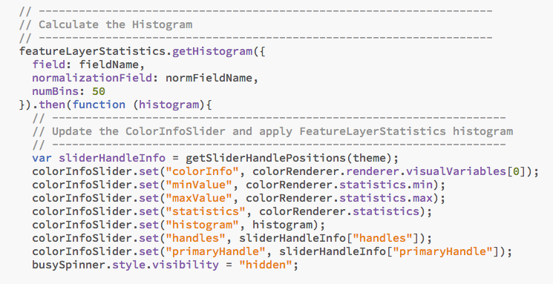

Slide 7




